Slide 1
Design and Analysis of Algorithms CS345
Lecture 32
NP Completeness – III
Coping with NP-completeness

Slide 2
NP Complete problems
If any NP-complete problem is solved in polynomial time
➔ P = NP
Is P = NP ?
P
NP
NP-complete

Slide 3



Showing a problem to be NP-complete
Let $X$be a problem which we wish to show to be NP-complete
Show that $X$ ϵ NP
Pick a problem $A$ which is already known to be NP-complete
Show that $A≤_{P}X$
NP
$$A$$
$$X$$

Slide 4
Example
Showing Dominating Set to be NP-complete

Slide 5







Dominating Set
Definition: Given an undirected graph $G=(V,E)$,
$N(u)$= {$v$| $v=u$ or ($u,v$) $∈E$}
In other words, $N(u)$ is the set consisting of $u$and all neighbors of $u$in $G$.
a subset $X⊆V$ is said to be an dominating set if
For each $u∈V$, $N\left(u\right)∩X≠∅$
Optimization version: compute dominating set of smallest size.
Decision version: Does there exist a dominating set of size $k$ ?
Is it the smallest dominating set ?
Is it the smallest dominating set ?
$$b$$
NO.
YES
$$a$$
$$x$$
$$z$$
$$t$$
$$y$$

Slide 6

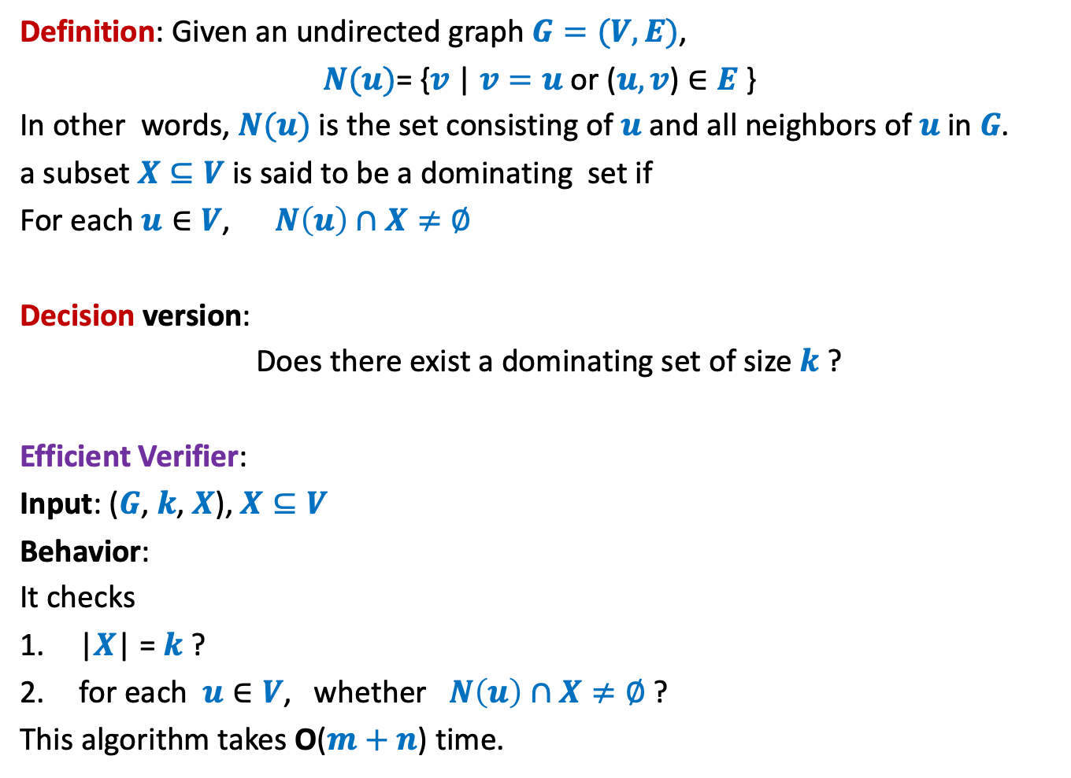
Dominating Set
Definition: Given an undirected graph $G=(V,E)$,
$N(u)$= {$v$| $v=u$ or ($u,v$) $∈E$}
In other words, $N(u)$ is the set consisting of $u$and all neighbors of $u$in $G$.
a subset $X⊆V$ is said to be a dominating set if
For each $u∈V$, $N\left(u\right)∩X≠∅$
Decision version:
Does there exist a dominating set of size $k$ ?
Efficient Verifier:
Input: ($G$, $k$, $X$), $X⊆V$
Behavior:
It checks
|$X$| = $k$ ?
for each $u∈V$, whether $N\left(u\right)∩X≠∅$ ?
This algorithm takes O($m+n$) time.
➔ Dominating Set $∈$ NP

Slide 7









VC $≤_{P}$ DS
VC: Vertex Cover
DS: Dominating Set
Input: a graph $G=(V,E)$ and $k∈Z^{+}$
Problem: Does there exist a vertex cover of size $≤k$?
Input: a graph $G=(V,E)$ and $t∈Z^{+}$
Problem: Does there exist a dominating set of size $≤t$ ?
$$b$$
$$b$$
$$a$$
$$x$$
$$a$$
$$x$$
$$z$$
$$t$$
$$z$$
$$t$$
$$y$$
$$y$$

Slide 8
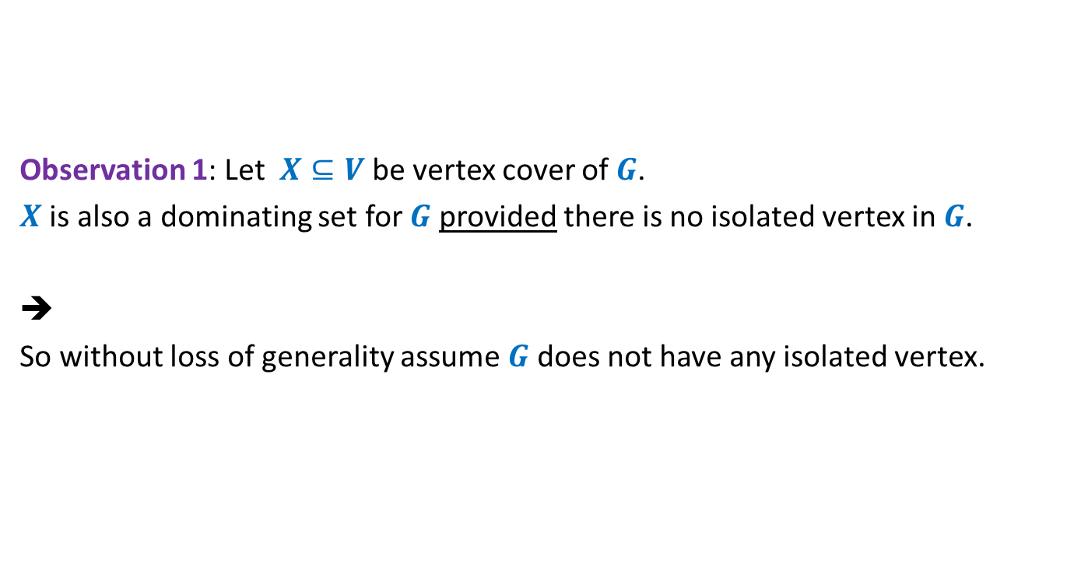
VC $≤_{P}$ DS
Observation 1: Let $X⊆V$ be vertex cover of $G$.
$X$ is also a dominating set for $G$ provided there is no isolated vertex in $G$.
➔
So without loss of generality assume $G$ does not have any isolated vertex.

Slide 9

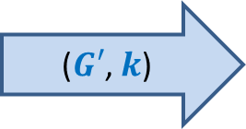
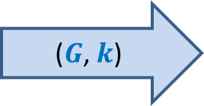

VC $≤_{P}$ DS
Aim: Given a graph $G=(V,E)$, how should $f$ transform it to graph $G′$ such that
$G$ has a vertex cover of size $≤k$if and only if $G′$has a dominating set of size $≤k$.
$$f$$
($G$, $k$)
($G′$, $k$)

Slide 10
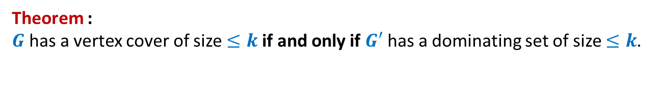






VC $≤_{P}$ DS
VC: Instance ($G$, $k$)
DS: Instance ($G′$, $k$)
$$b$$
$$b$$
$$a$$
$$x$$
$$a$$
$$x$$
$$z$$
$$t$$
$$z$$
$$t$$
$$y$$
$$y$$
Theorem :
$G$ has a vertex cover of size $≤k$if and only if $G′$ has a dominating set of size $≤k$.

Slide 11
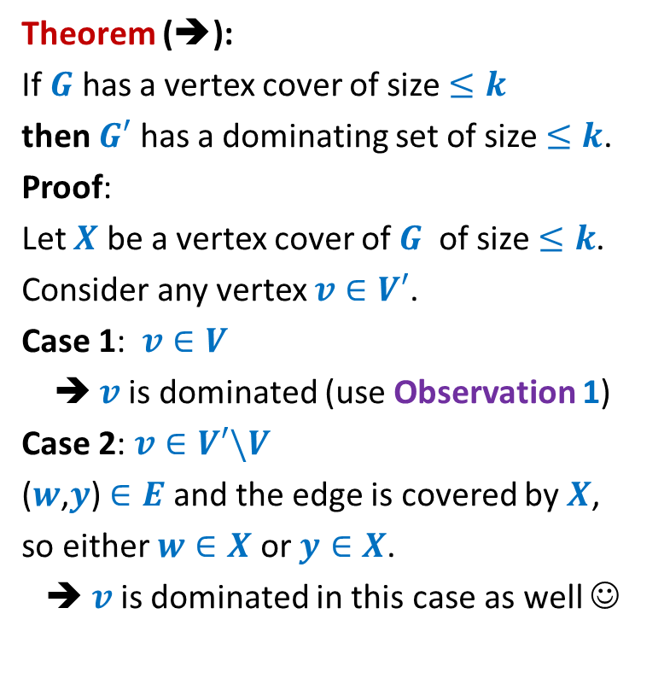




VC $≤_{P}$ DS
Theorem (➔):
If $G$ has a vertex cover of size $≤k$
then $G′$ has a dominating set of size $≤k$.
Proof:
Let $X$ be a vertex cover of $G$ of size $≤k$.
Consider any vertex $v∈V′$.
Case 1: $v∈V$
➔ $v$is dominated (use Observation 1)
Case 2: $v∈V′\backslash V$
($w$,$y$) $∈E$ and the edge is covered by $X$,
so either $w∈X$ or $y∈X$.
➔ $v$is dominated in this case as well ☺
$$v$$
$$y$$
$$v$$
$$w$$
$$y$$

Slide 12

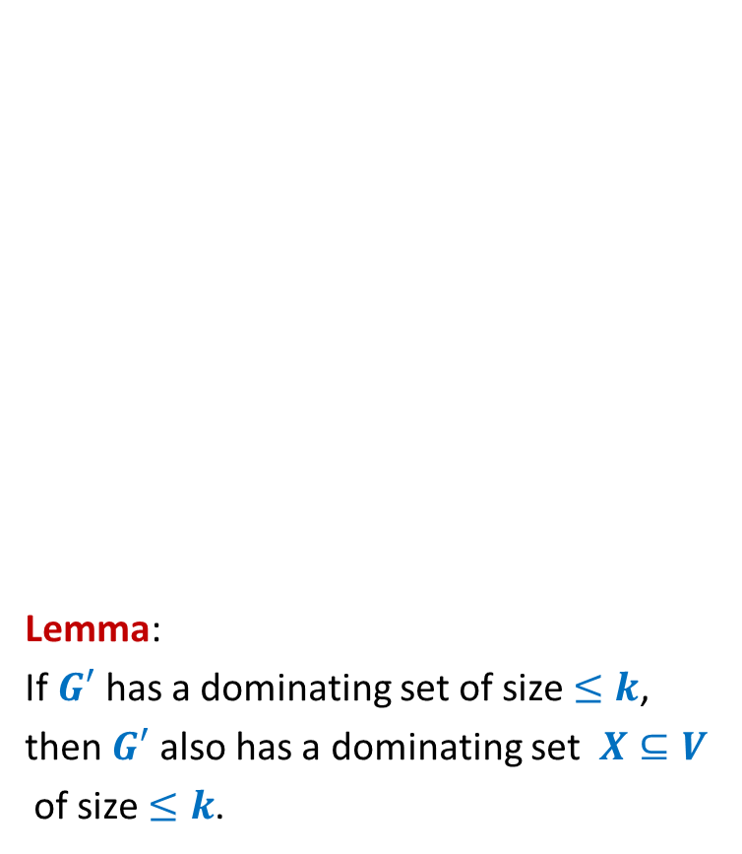
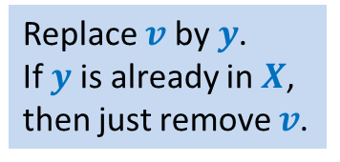
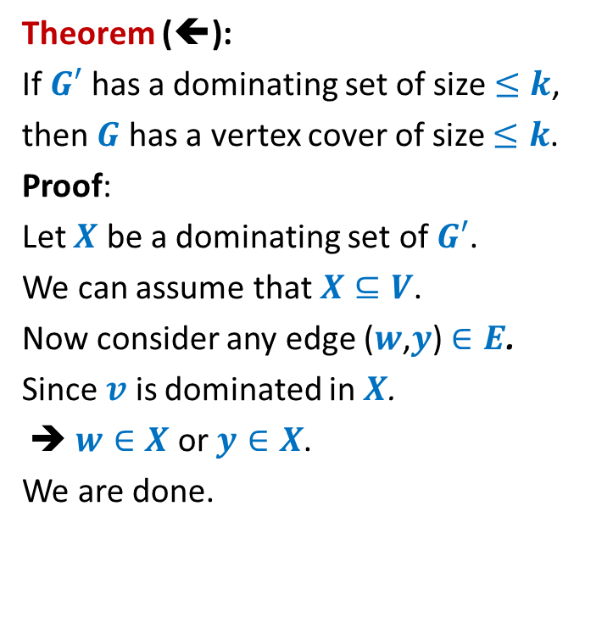

VC $≤_{P}$ DS
Replace $v$ by $y$.
If $y$ is already in $X$,
then just remove $v$.
Lemma:
If $G′$ has a dominating set of size $≤k$,
then $G′$ also has a dominating set $X⊆V$
of size $≤k$.
Theorem (⬅):
If $G′$ has a dominating set of size $≤k$,
then $G$ has a vertex cover of size $≤k$.
Proof:
Let $X$ be a dominating set of $G′$.
We can assume that $X⊆V$.
Now consider any edge ($w$,$y$) $∈E$.
Since $v$ is dominated in $X$.
➔ $w∈X$ or $y∈X$.
We are done.
$$v$$
$$w$$
$$y$$
$$v$$
$$w$$
$$y$$

Slide 13
More NP-complete Problems

Slide 14



















Subgraph Isomorphism
$a$→$1$
$$1$$
$$2$$
Definition: Graph $G=(V,E)$ is said to be isomorphic to $G′=(V′,E′)$
if there is a bijection $f$ : $V$→ $V′$ such that for any two vertices $u,v∈V$
$\left(u,v\right)∈E$ if and only if
Problem: Given two graphs $G$ and $G′$,
does there exist a subgraph of $G$ which is isomorphic to $G′$ ?
Homework: Show that subgraph isomorphism problem is NP-complete.
$$a$$
$$u$$
$b$→$3$
$c$→$5$
$$b$$
$$v$$
$u$→$2$
$$6$$
$$3$$
$v$→$4$
$$c$$
$$w$$
$w$→$6$
$$5$$
$$4$$
$$\left(f(u),f(v\right))∈E′$$

Slide 15
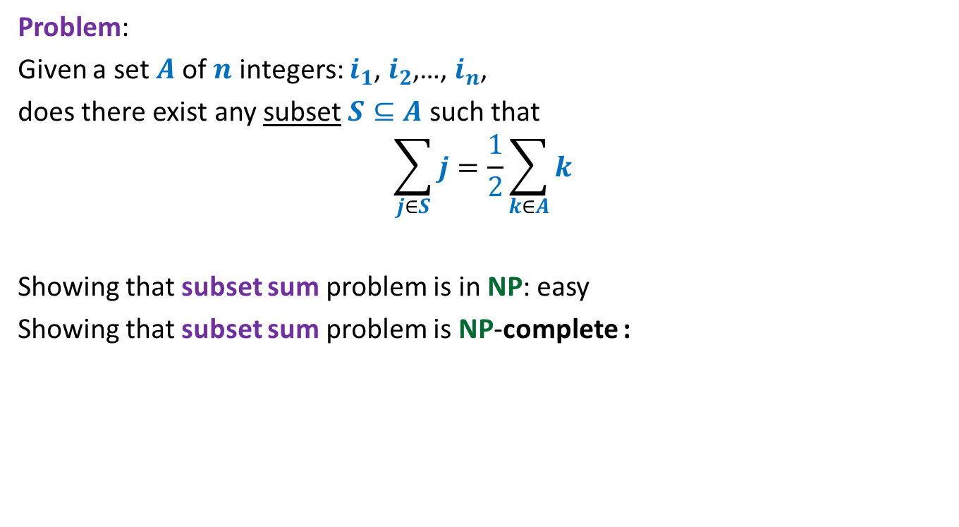
Subset sum problem
Problem:
Given a set $A$of $n$ integers: $i_{1}$, $i_{2}$,…, $i_{n}$,
does there exist any subset $S⊆A$ such that
$$\sum_{j∈S}{j}=\frac{1}{2}\sum_{k∈A}{k}$$
Showing that subset sum problem is in NP: easy
Showing that subset sum problem is NP-complete :
neither Homework
nor Exam problem

Slide 16
How to handle NP-complete Problems
Approximation Algorithms

Slide 17
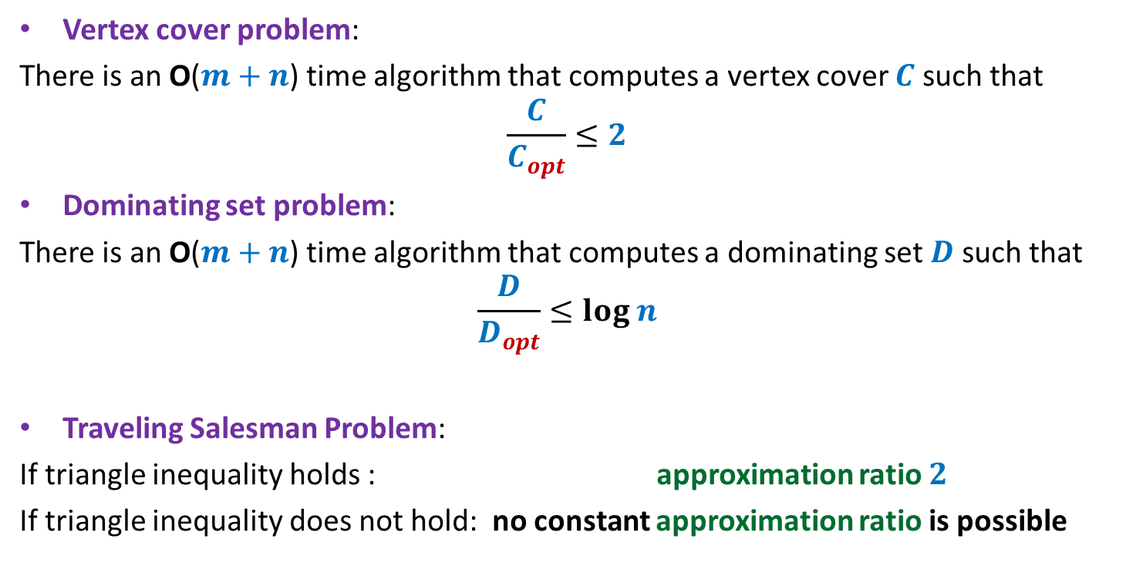
Approximation algorithms
Vertex cover problem:
There is an O($m+n$) time algorithm that computes a vertex cover $C$ such that
$$\frac{C}{C_{opt}}≤2$$
Dominating set problem:
There is an O($m+n$) time algorithm that computes a dominating set $D$ such that
$$\frac{D}{D_{opt}}≤log n$$
Traveling Salesman Problem:
If triangle inequality holds : approximation ratio $2$
If triangle inequality does not hold: no constant approximation ratio is possible

Slide 18

VERTEX Cover Problem
an O($m+n$) time algorithm
$2$-approximate solution

Slide 19
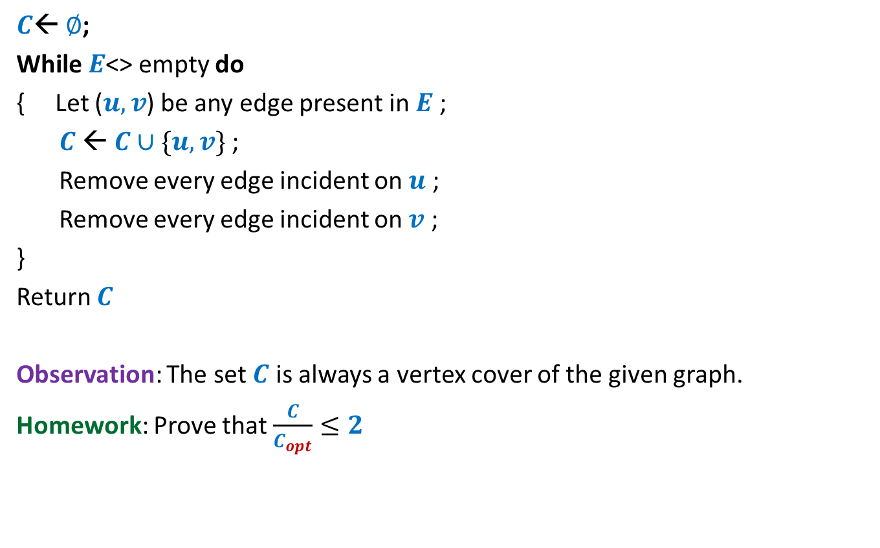
The algorithm
$C$← $∅$;
While $E$<> empty do
{ Let ($u,v$) be any edge present in $E$ ;
$C$← $C∪\{u,v\}$;
Remove every edge incident on $u$ ;
Remove every edge incident on $v$ ;
}
Return $C$
Observation: The set $C$ is always a vertex cover of the given graph.
Homework: Prove that $\frac{C}{C_{opt}}≤2$
?

Slide 20
Set Cover Problem

Slide 21










Set Cover Problem
a set $A$= {$e_{1}$, $e_{2}$,…,$e_{n}$}
$S_{1}$, $S_{2}$,…, $S_{k}$, with $S_{i}⊆A$
Optimization version: Compute least number of sets that can cover $A$.
Decision version: Does there exist $j$subsets that can cover all elements ?
$$e_{2}$$
$$e_{7}$$
$$e_{5}$$
$$e_{1}$$
$$e_{3}$$
$$e_{8}$$
$$e_{4}$$
$$e_{6}$$
$$e_{9}$$

Slide 22
Set Cover Problem
a set $A$= {$e_{1}$, $e_{2}$,…,$e_{n}$}
$S_{1}$, $S_{2}$,…, $S_{k}$, with $S_{i}⊆A$
Optimization version: Compute least number of sets that can cover $A$.
Decision version: Does there exist $j$subsets that can cover all elements ?
$$e_{2}$$
$$e_{7}$$
$$e_{5}$$
$$e_{1}$$
$$e_{3}$$
$$e_{8}$$
$$e_{4}$$
$$e_{6}$$
$$e_{9}$$

Slide 23
Set Cover Problem
a set $A$= {$e_{1}$, $e_{2}$,…,$e_{n}$}
$S_{1}$, $S_{2}$,…, $S_{k}$, with $S_{i}⊆A$
Optimization version: Compute least number of sets that can cover $A$.
Decision version: Does there exist $j$subsets that can cover all elements ?
$$e_{2}$$
$$e_{7}$$
$$e_{5}$$
$$e_{1}$$
$$e_{3}$$
$$e_{8}$$
$$e_{4}$$
$$e_{6}$$
$$e_{9}$$

Slide 24
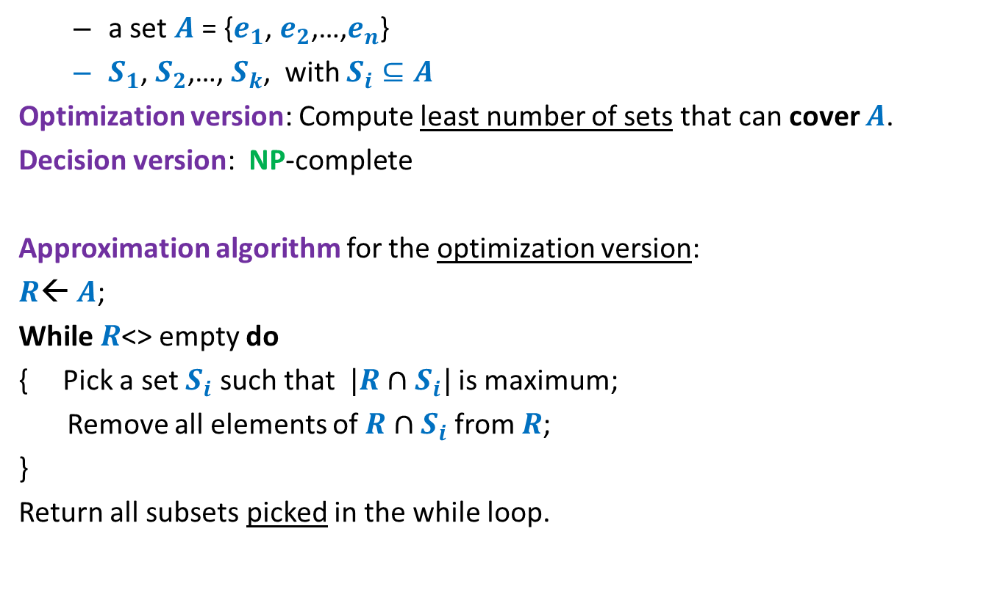
Set Cover Problem
a set $A$= {$e_{1}$, $e_{2}$,…,$e_{n}$}
$S_{1}$, $S_{2}$,…, $S_{k}$, with $S_{i}⊆A$
Optimization version: Compute least number of sets that can cover $A$.
Decision version: NP-complete
Approximation algorithm for the optimization version:
$R$← $A$;
While $R$<> empty do
{ Pick a set $S_{i}$ such that $|R∩S_{i}|$ is maximum;
Remove all elements of $R∩S_{i}$ from $R$;
}
Return all subsets picked in the while loop.
Homework
Think simple.
Follow your intuition

